Slide 1
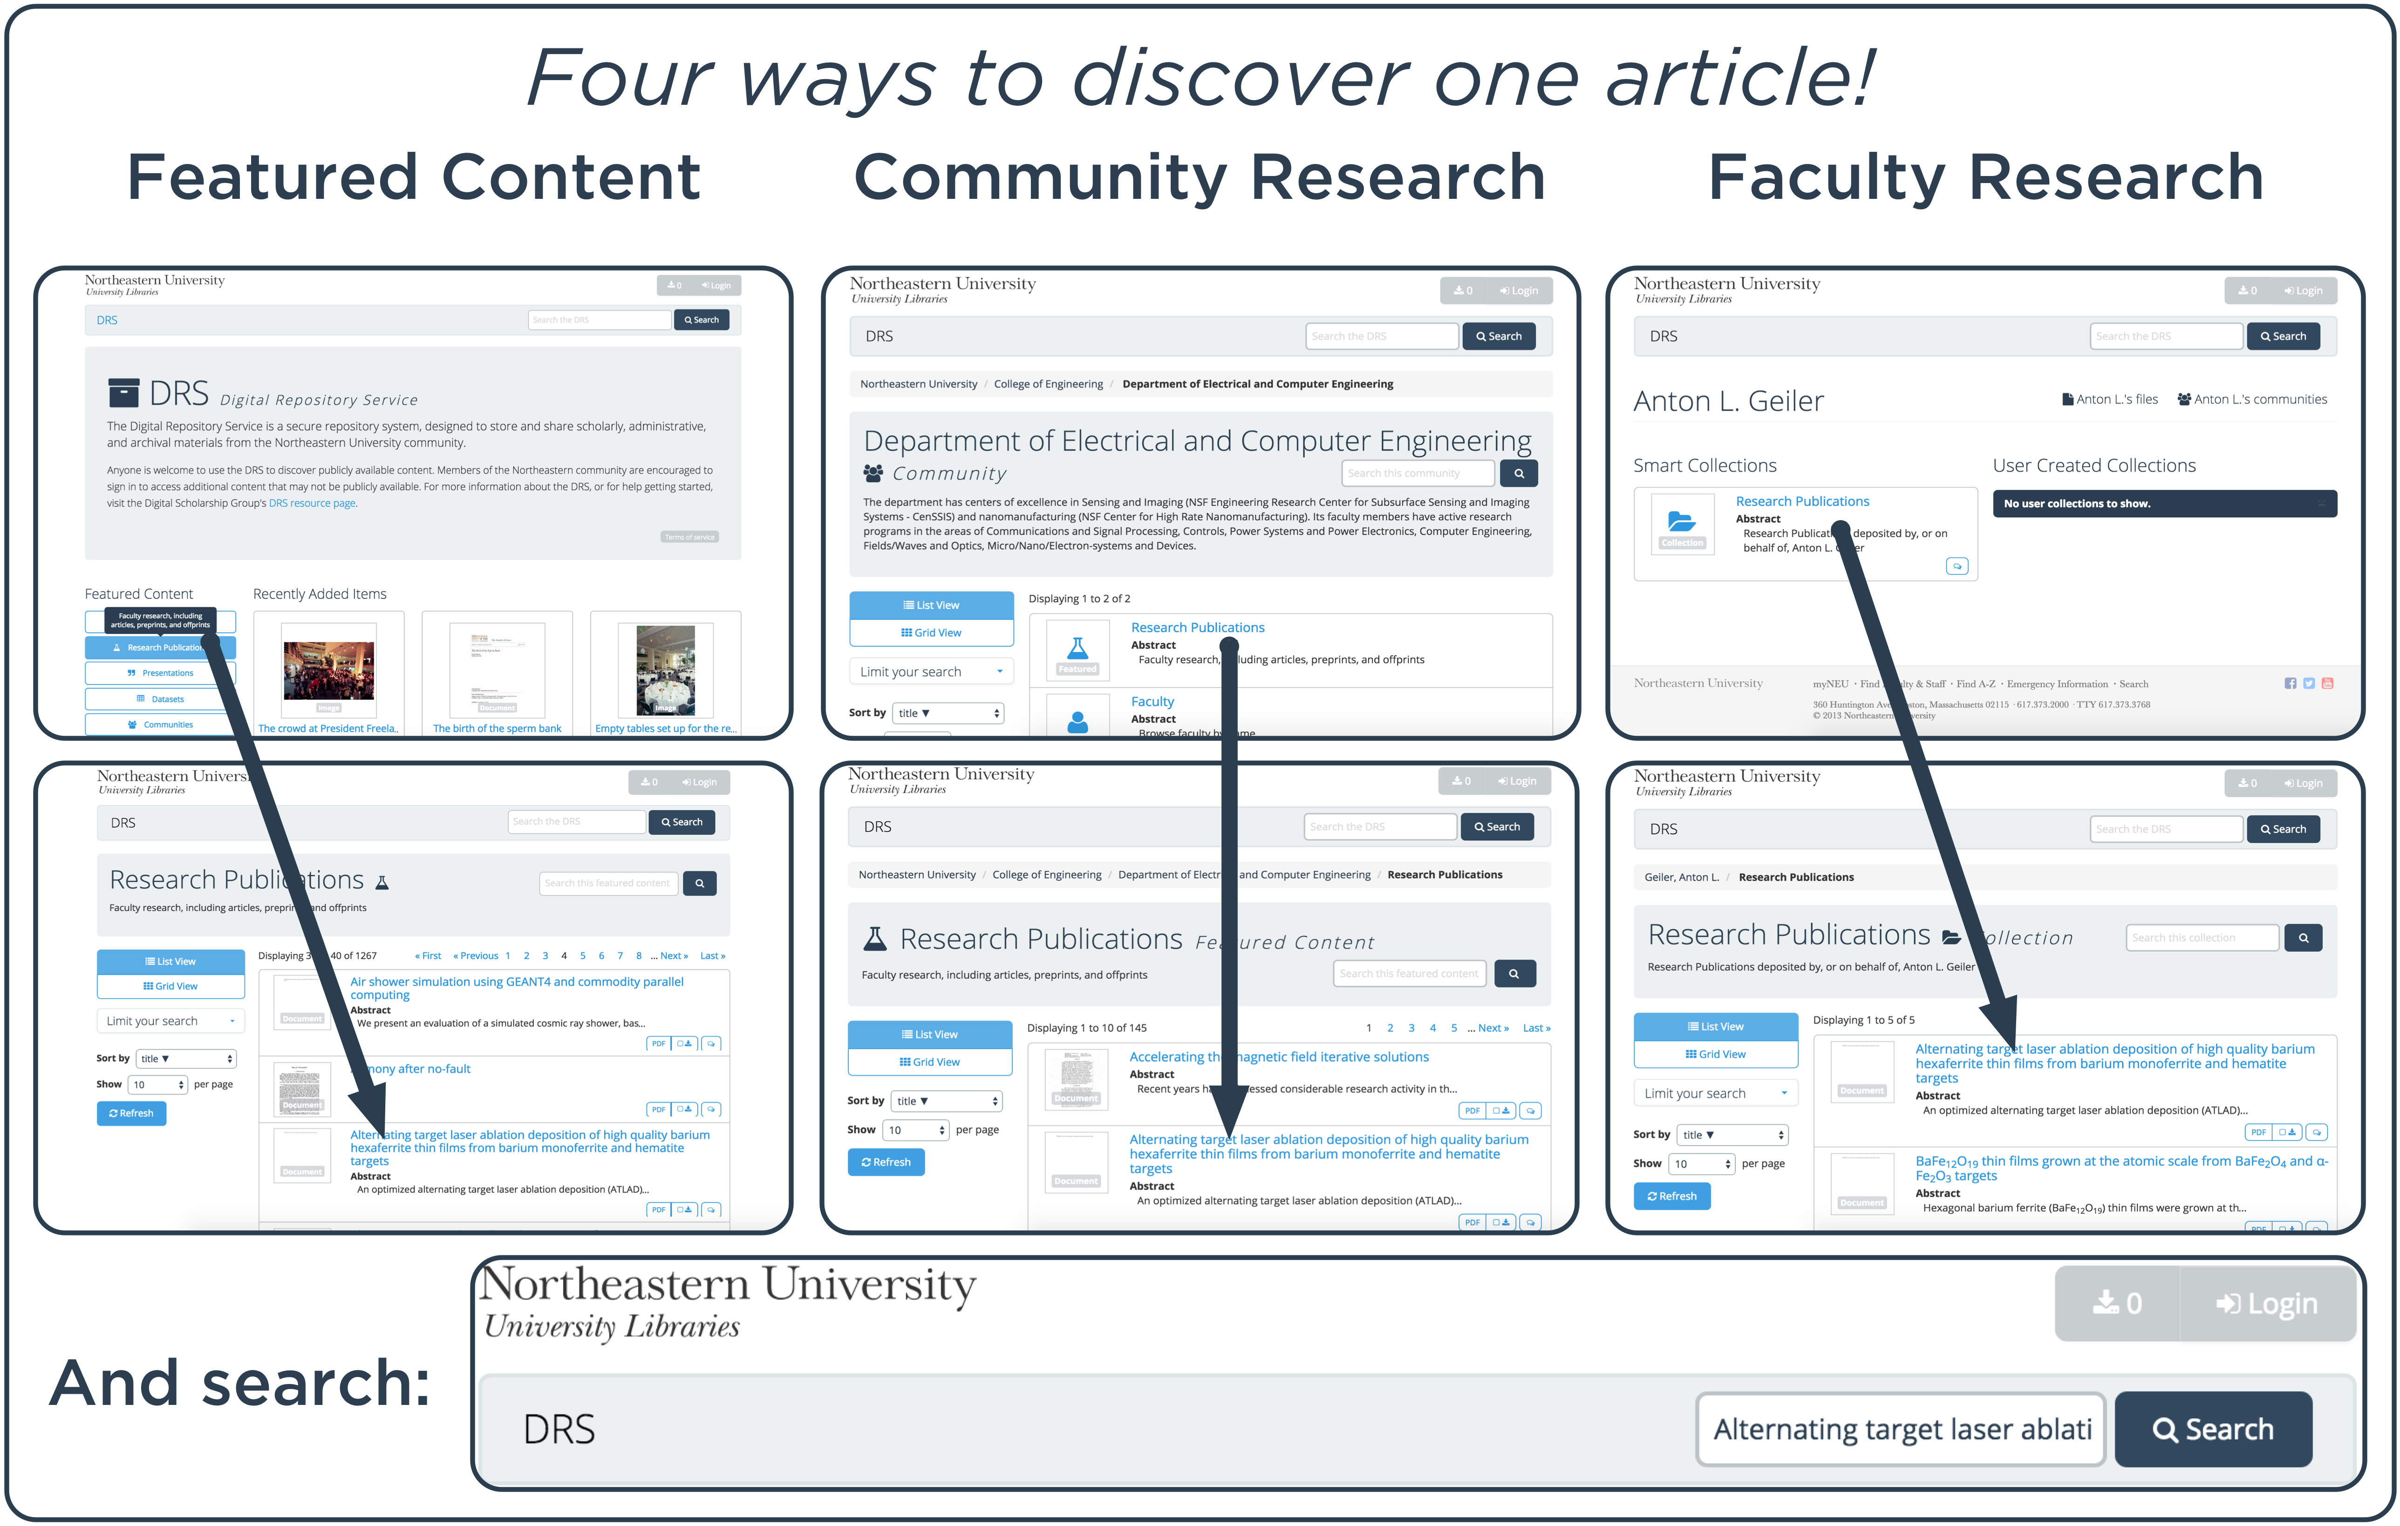

Using Communities to Highlight Scholarly Content in Hydra
Sarah Sweeney
Digital Repository Manager
Northeastern University Library
repository.library.northeastern.edu
Notes:
Promotional Slide

Slide 2

Using Communities to Highlight Scholarly Content in Hydra
repository.library.northeastern.edu
Sarah Sweeney (sj.sweeney@neu.edu)
Notes:
Promotional Slide

Slide 3
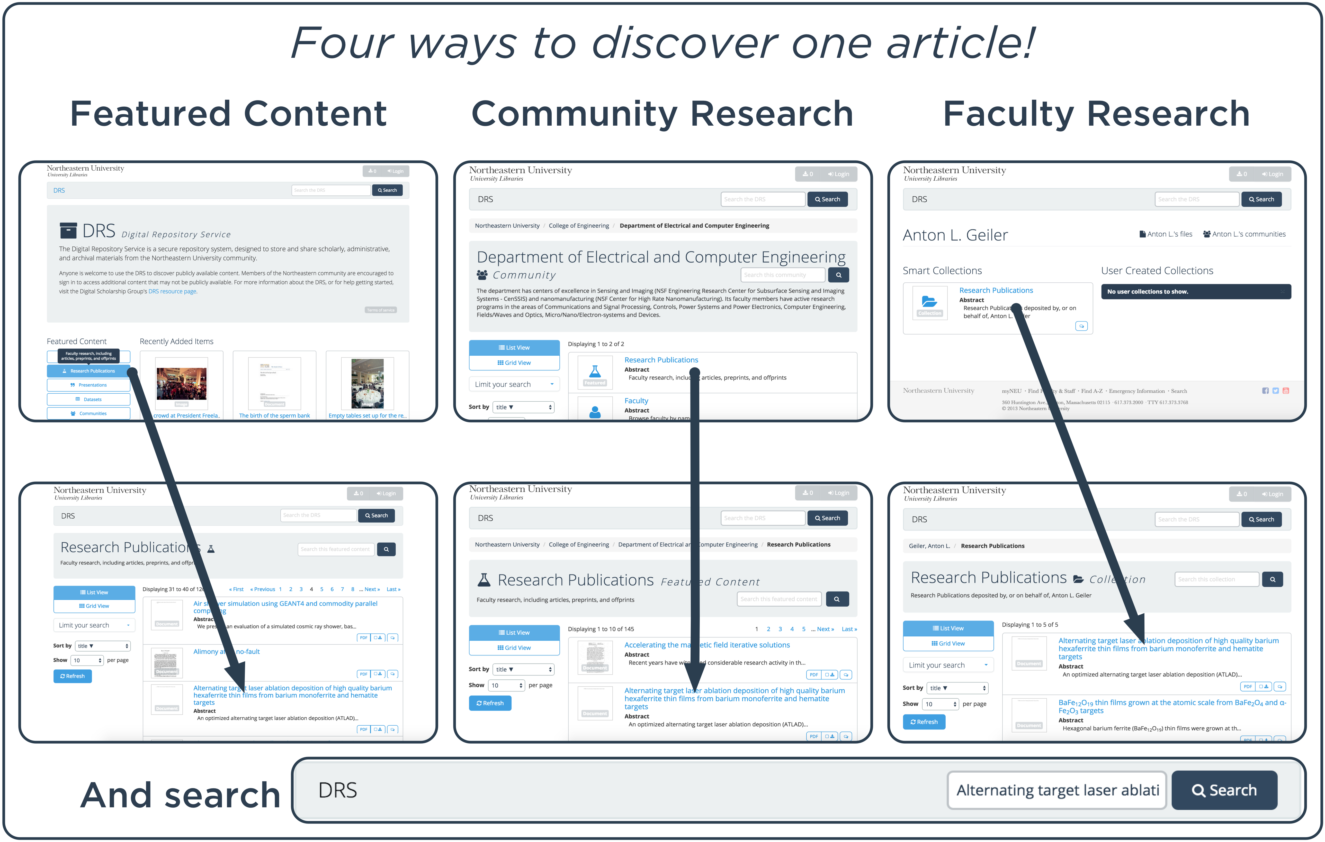
Using Communities to Highlight Scholarly Content in Hydra
Northeastern University Library
Sarah Sweeney sj.sweeney@neu.edu
repository.library.northeastern.edu
Notes:
Promotional Slide

